Slide 1
Lecture 10 File upload Sending text by email

Slide 2
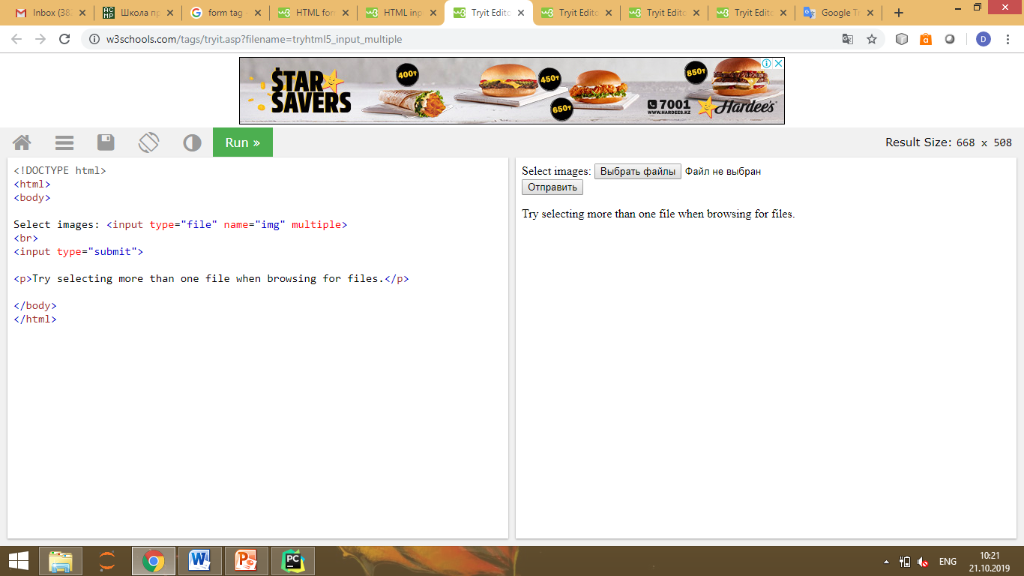
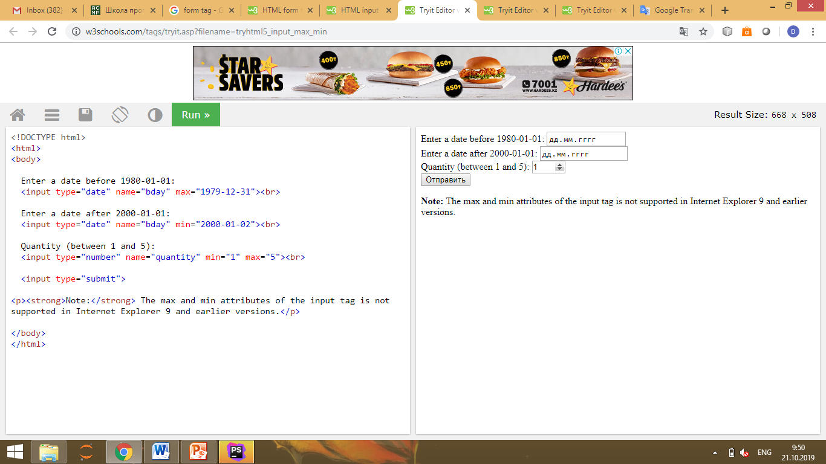
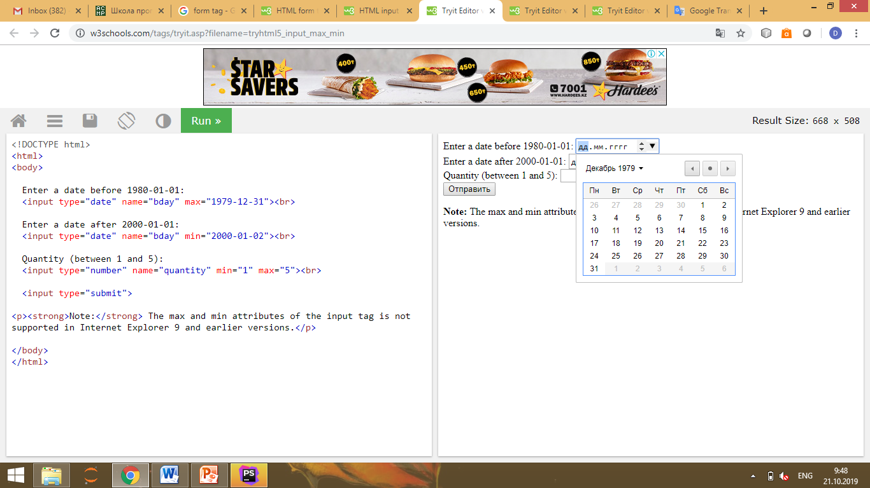
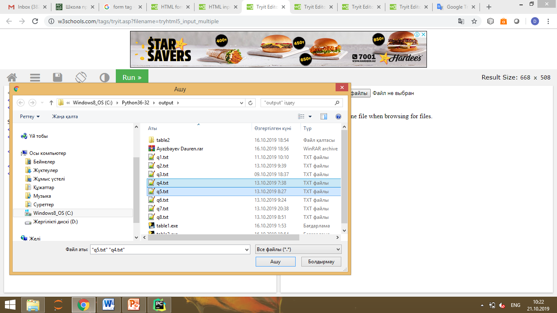
Web programming: front end

Slide 3
File uploading configuration
Laravel's filesystem configuration file is located at config/filesystems.php. Within this file, you may configure all of your filesystem "disks". Each disk represents a particular storage driver and storage location. Example configurations for each supported driver are included in the configuration file so you can modify the configuration to reflect your storage preferences and credentials. The local driver interacts with files stored locally on the server running the Laravel application while the s3 driver is used to write to Amazon's S3 cloud storage service.

Slide 4
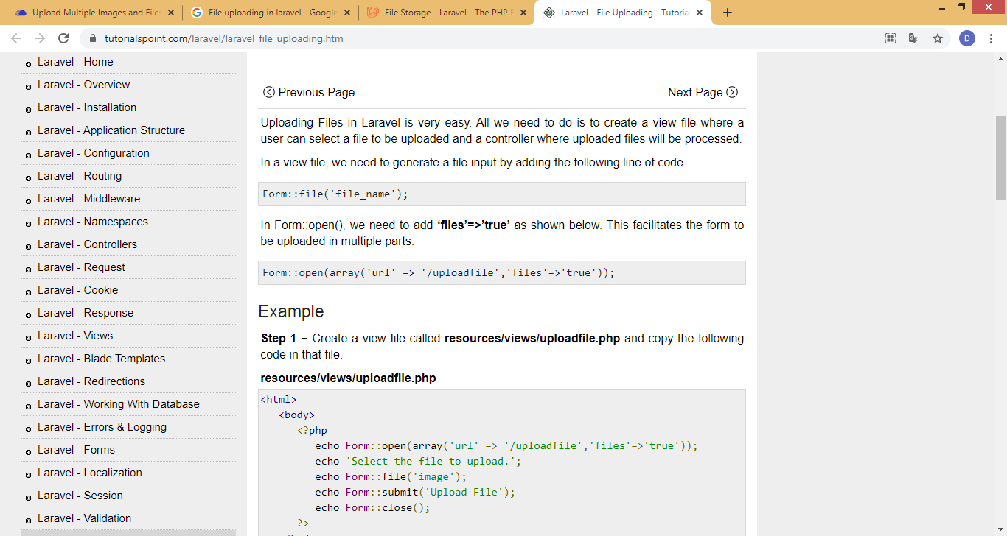
File uploading
Uploading Files in Laravel is very easy. All we need to do is to make a view file where a user can select a file to be uploaded and a controller where uploaded files will be processed.
In a view file, we need to generate a file input by adding the following line of code. In Form::open(), we need to add ‘files’=>’true’ as shown below. This facilitates the form to be uploaded in multiple parts.

Slide 5
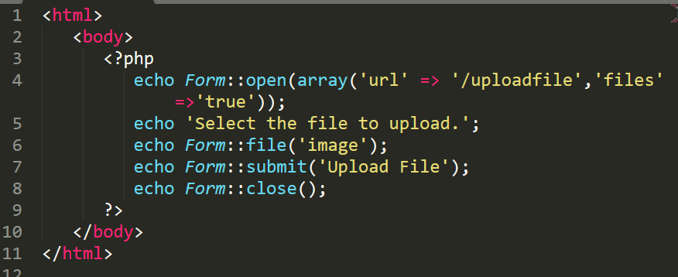
Step 1
resources/views/file_upload.php

Slide 6
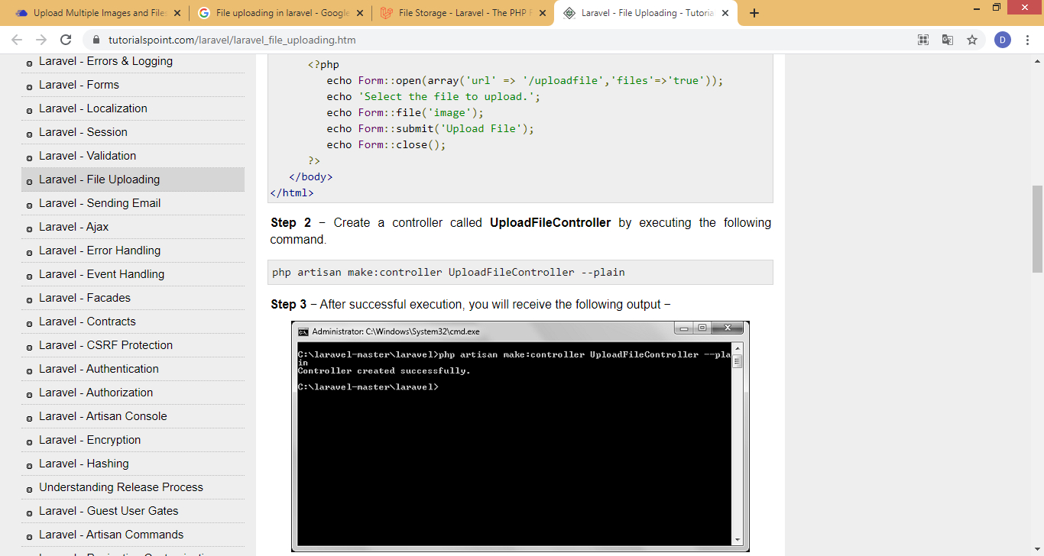
Step 2
Make a controller called UploadFileController by executing the following command.

Slide 7
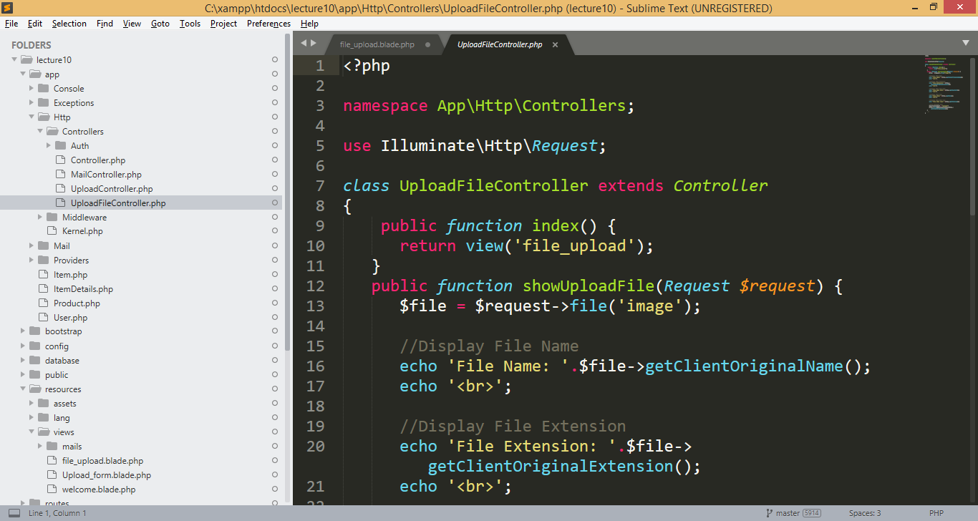
UploadFileController.php file

Slide 8
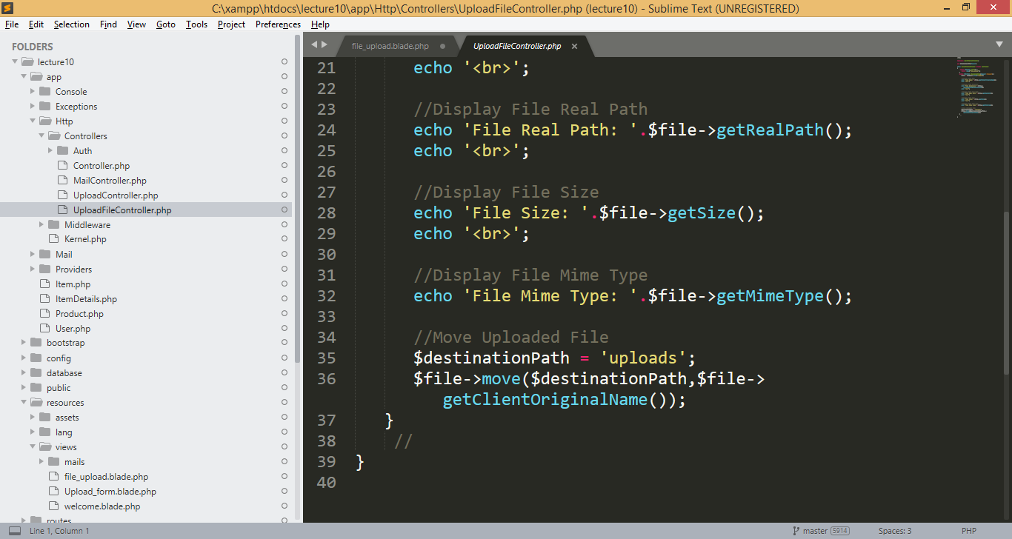
UploadFileController.php file

Slide 9
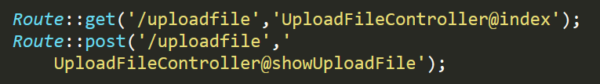
Step 3
Add following routes to web.php file.

Slide 10
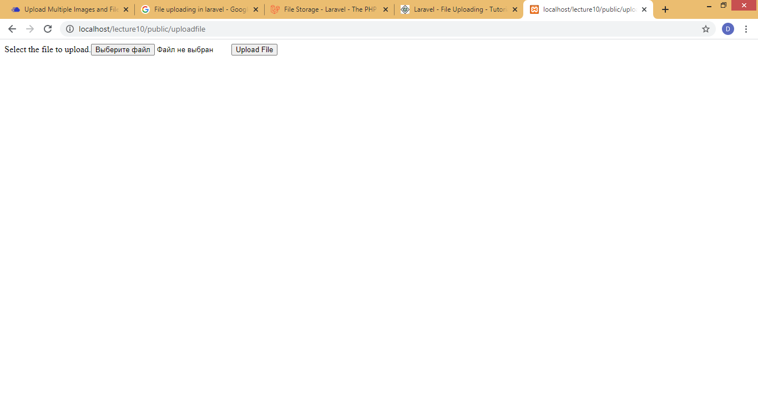
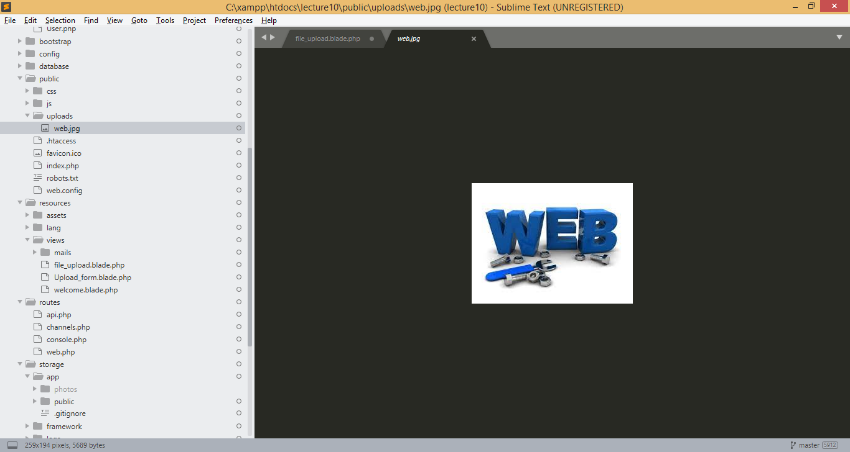

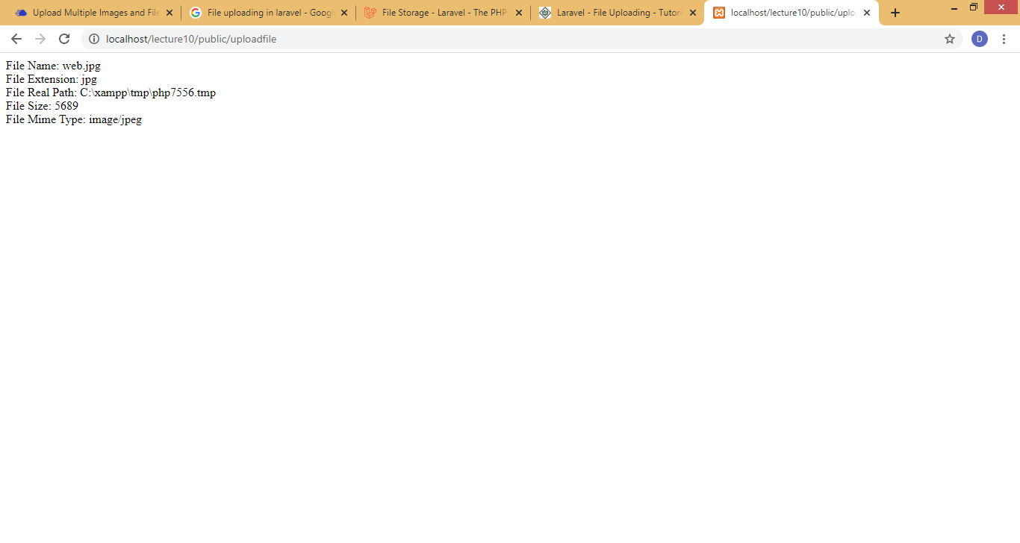
Result

Slide 11
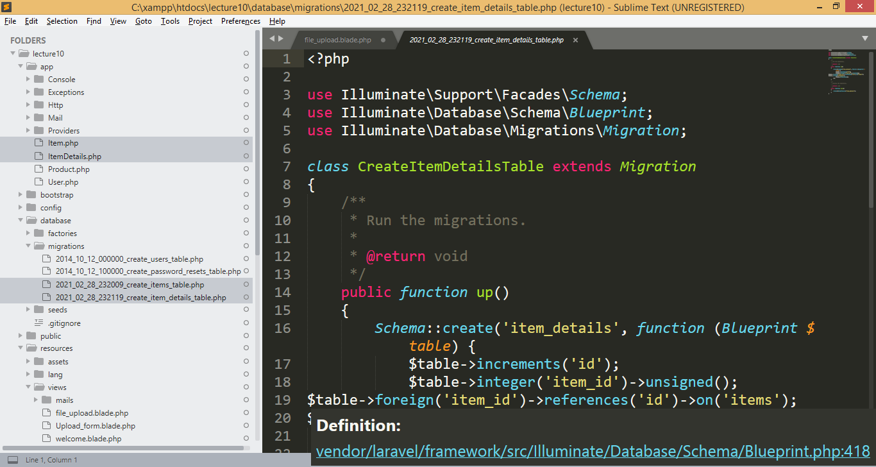
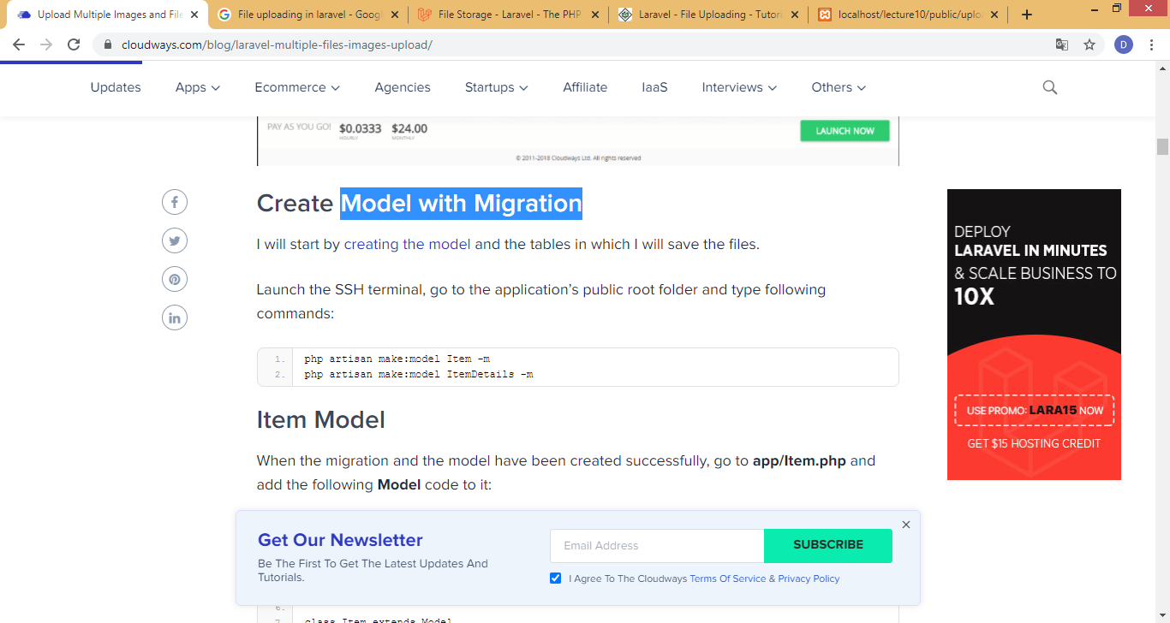
Uploading Multiple Images and Files in Laravel with Validation
Make model with migration.

Slide 12
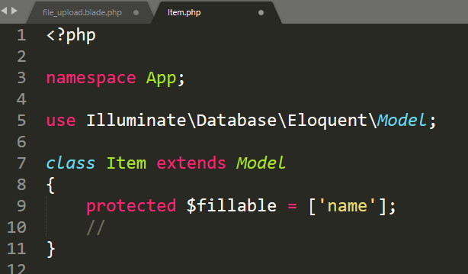
Item Model
When the migration and the model have been made successfully, go to app/Item.php and add the following Model code to it:

Slide 13
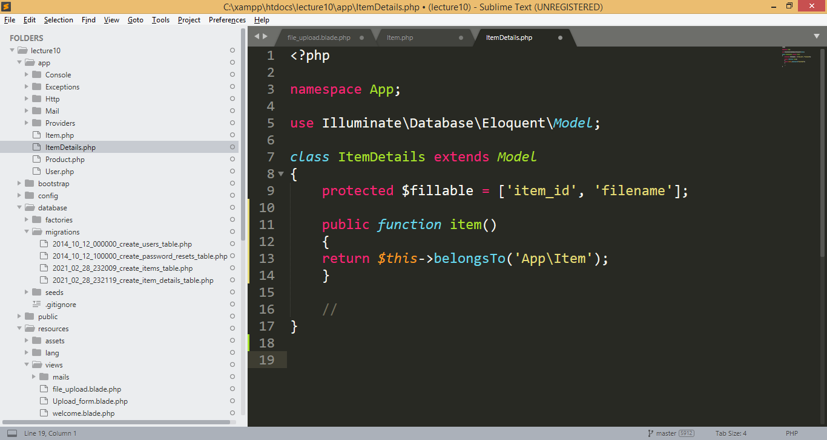
Model Of ItemDetails
The model comprises of the following code:
In this code belongTo was
used because itemDetails
belongs to Item table and
item_id is the foreign key.
This is known as inverse
relation in Laravel.

Slide 14
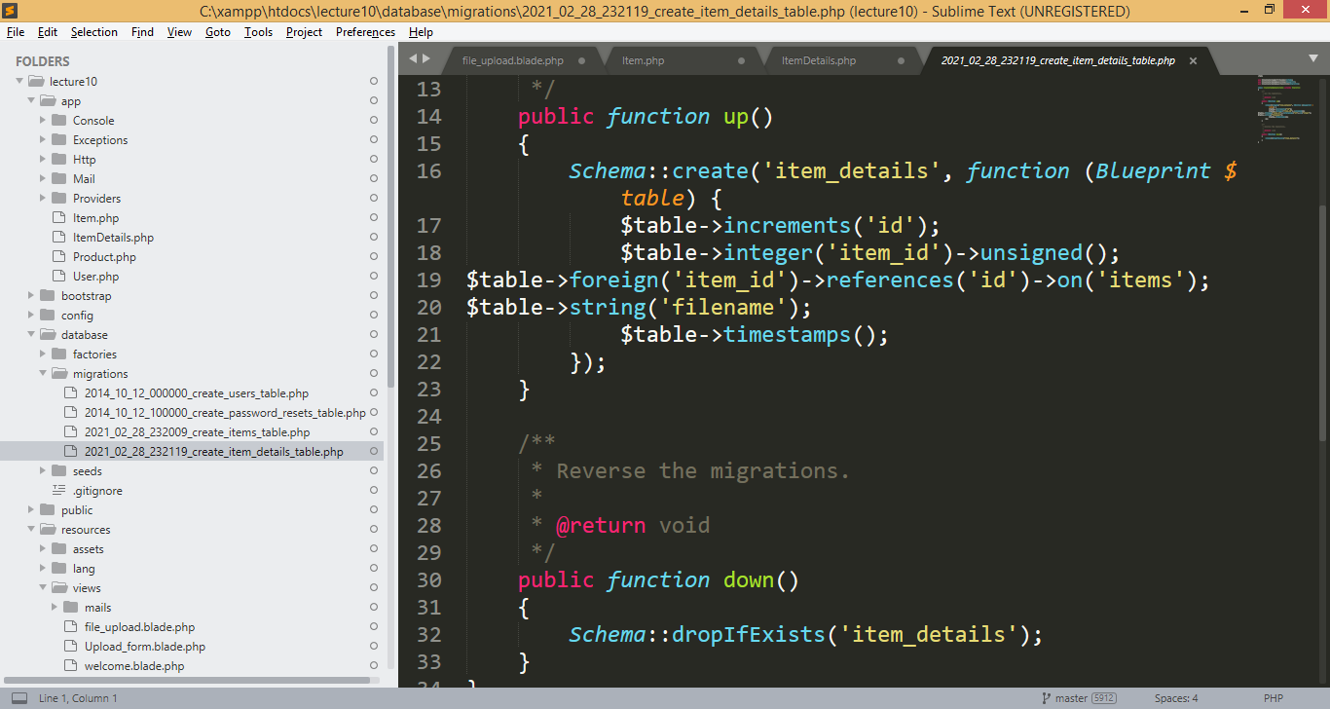
Migration of ItemDetails Table

Slide 15
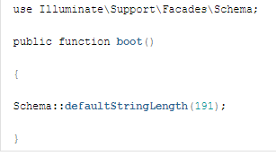
AppServiceProvider.php file
Next , In the app/Providers/AppServiceProvider.php file, the boot method set a default string length:

Slide 16
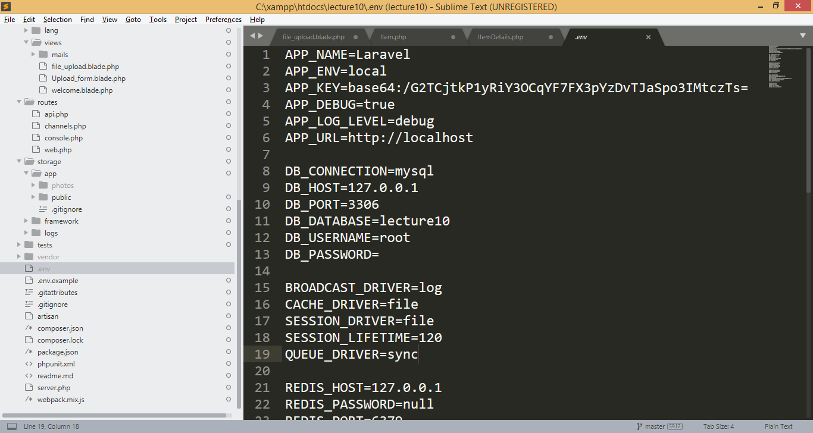
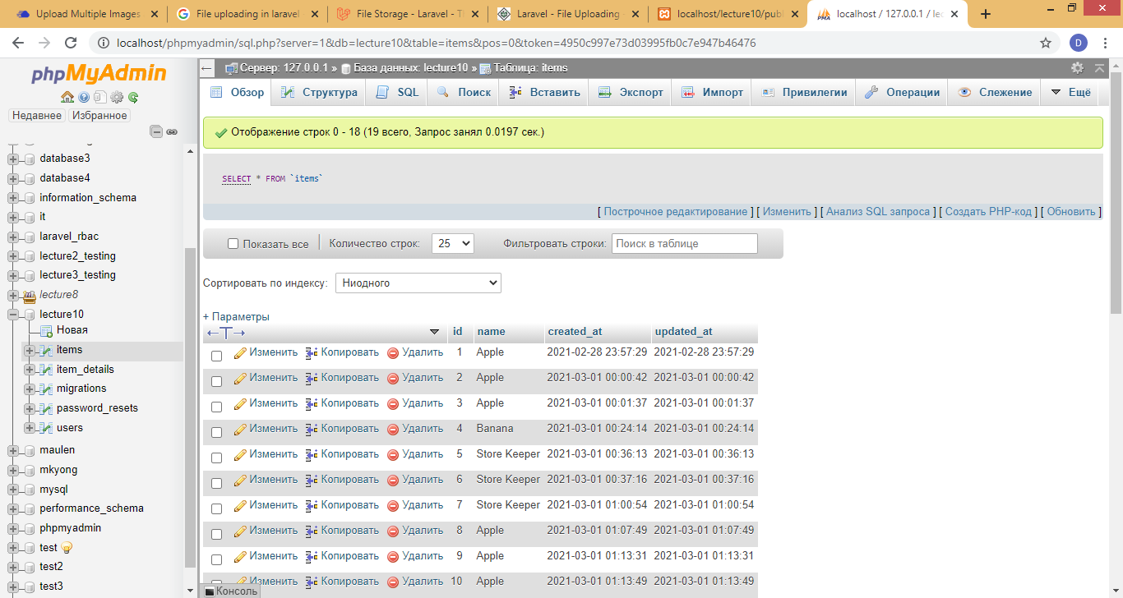
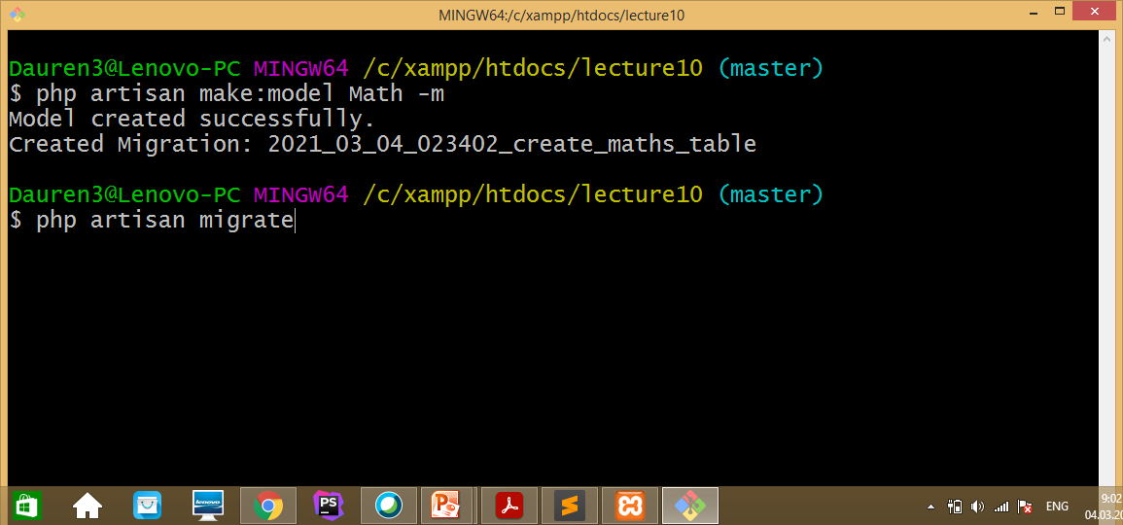
Database Configuration
.env file

Slide 17
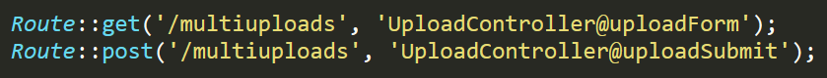
Setting up routes
Route sets the application URL and the controller method for this URL.
routes/web.php

Slide 18
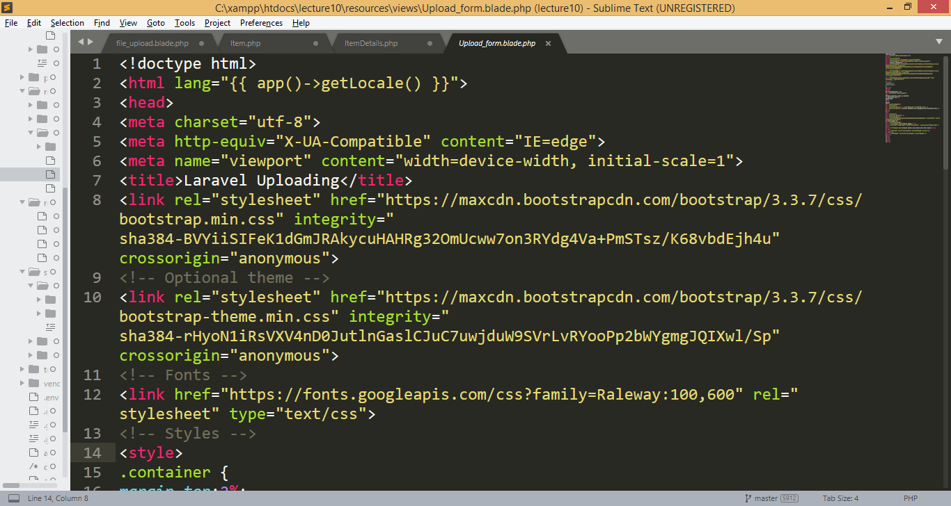
Upload_form.blade.php file
In this view Bootstrap library was used to style HTML element.

Slide 19
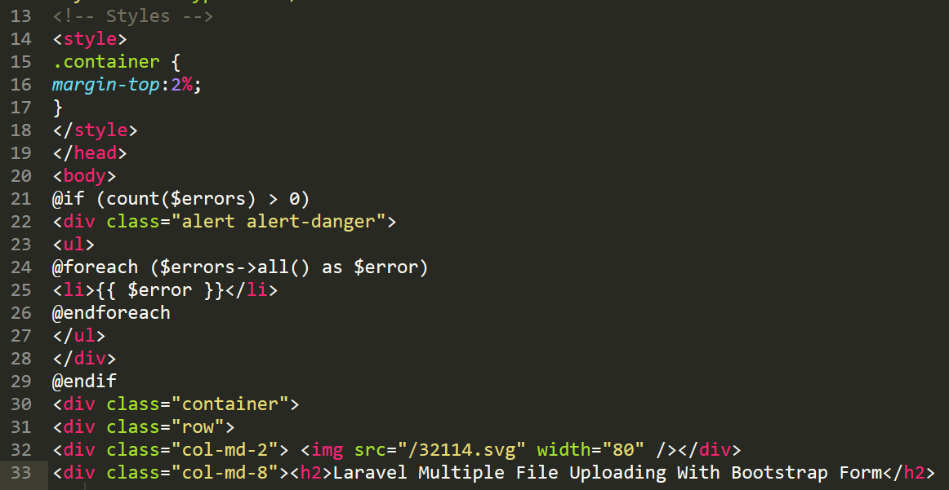
Upload_form.blade.php file(continuation)

Slide 20
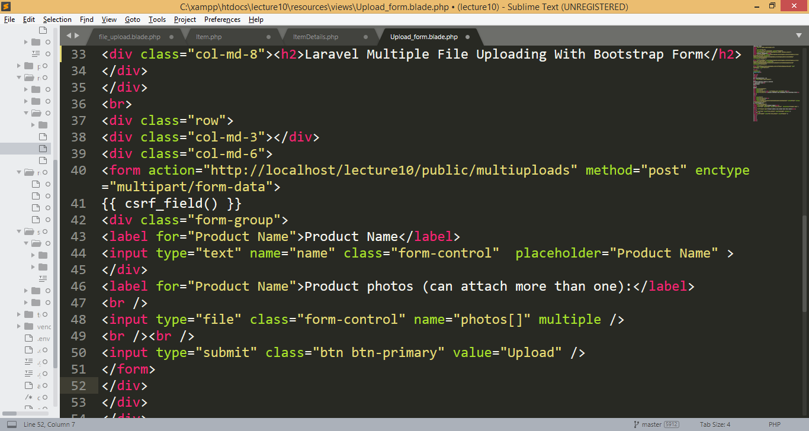
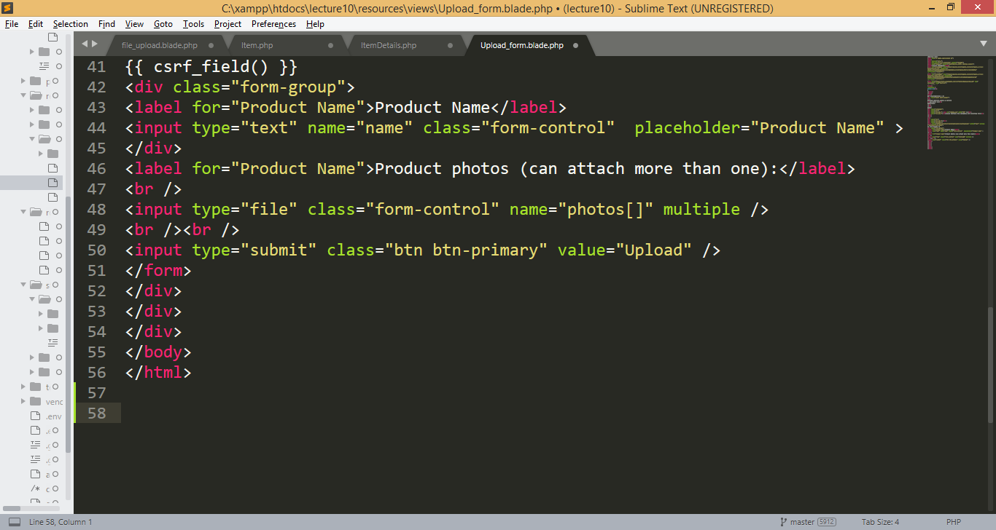
Upload_form.blade.php file(continuation)

Slide 21
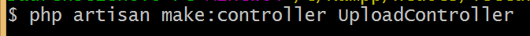
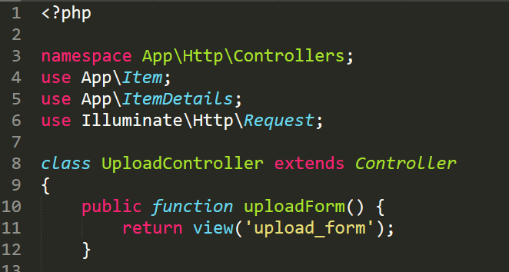
Controller with Validation

Slide 22
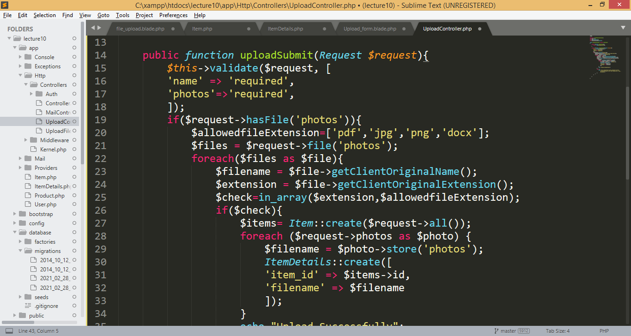
Controller with Validation

Slide 23
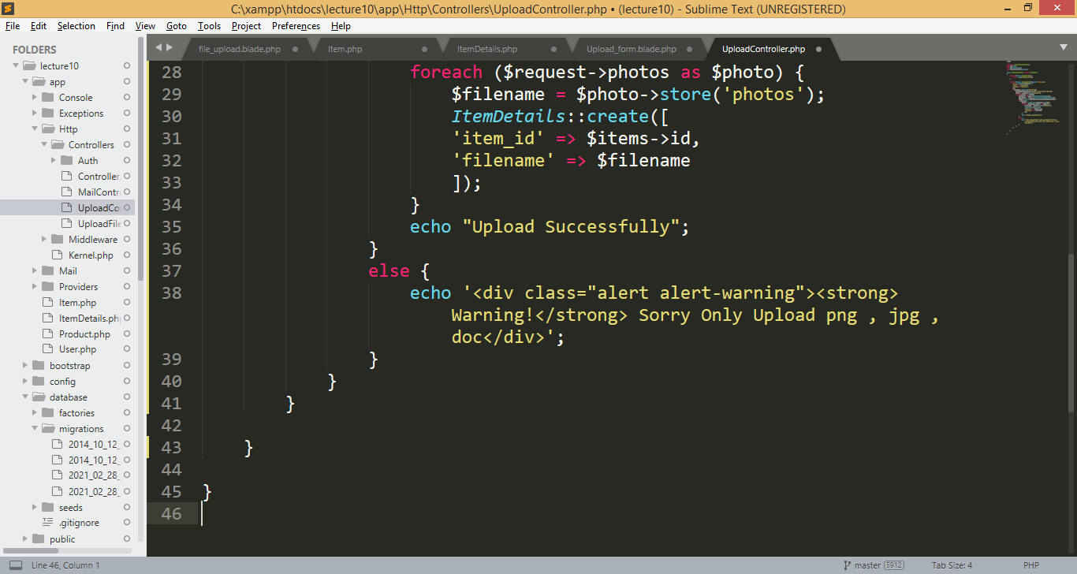
Controller with Validation

Slide 24
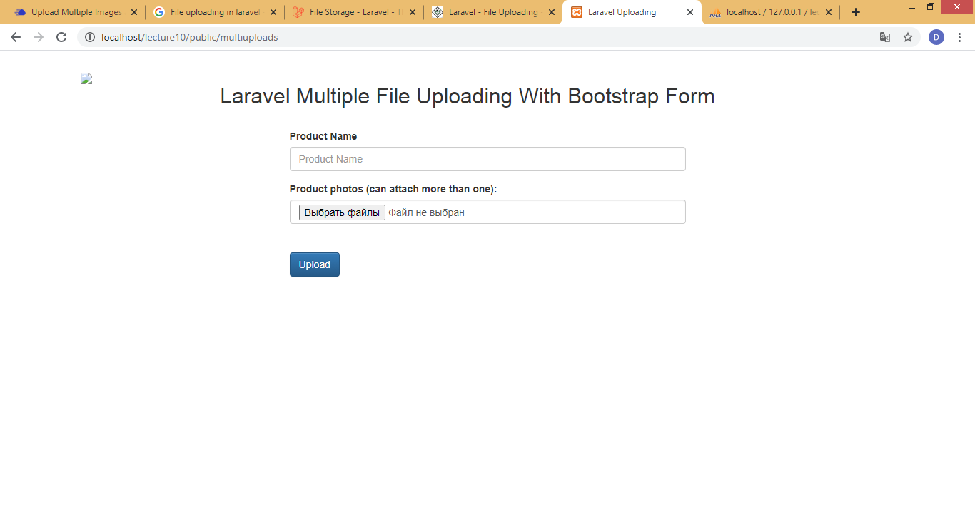
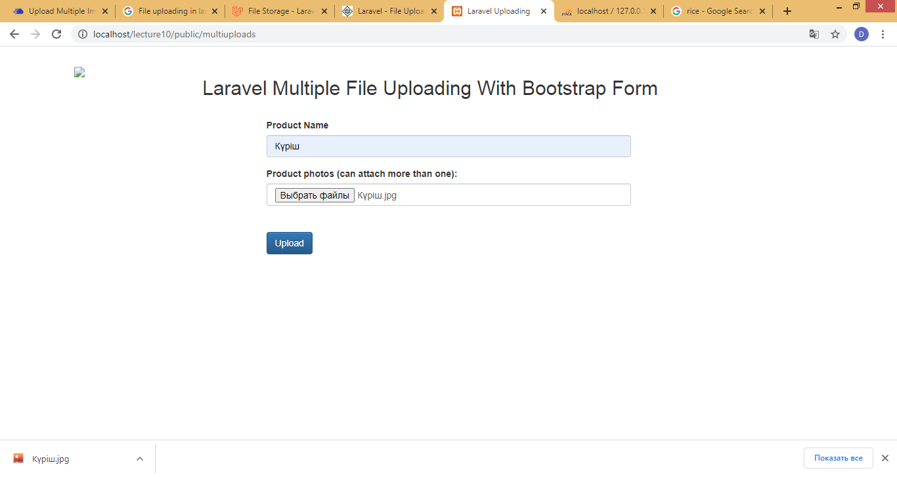
Result

Slide 25
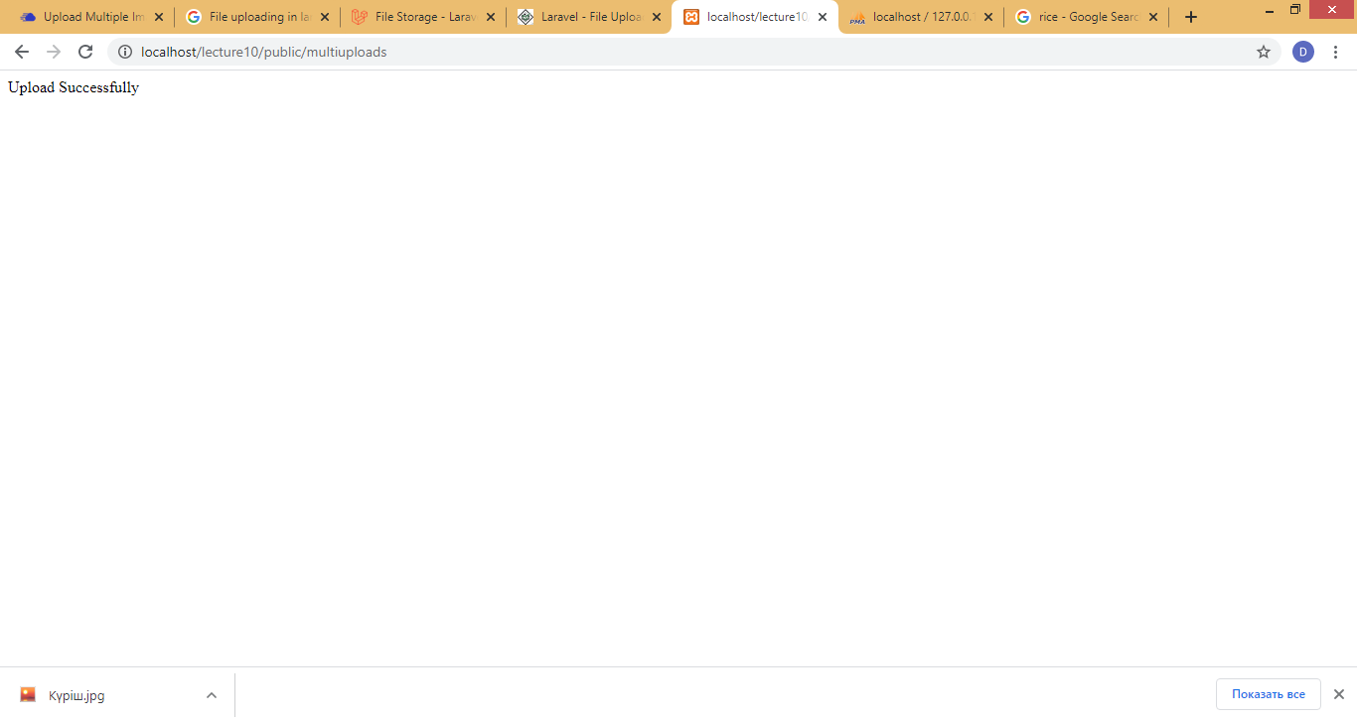
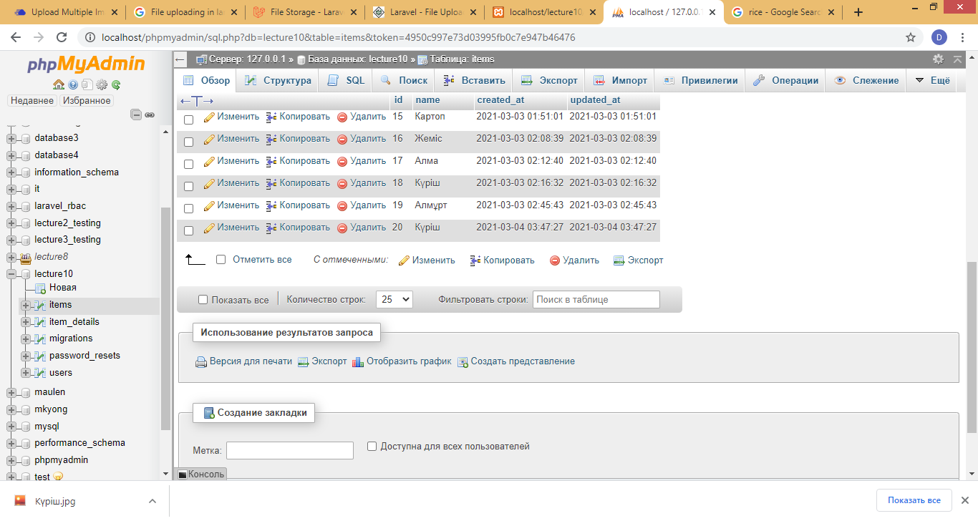
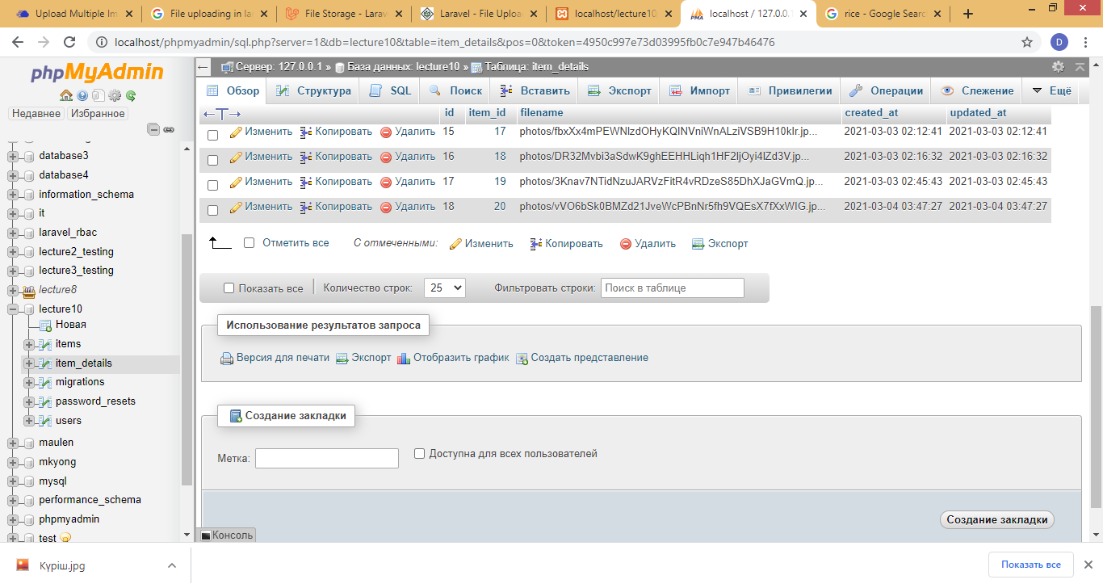
Result

Slide 26
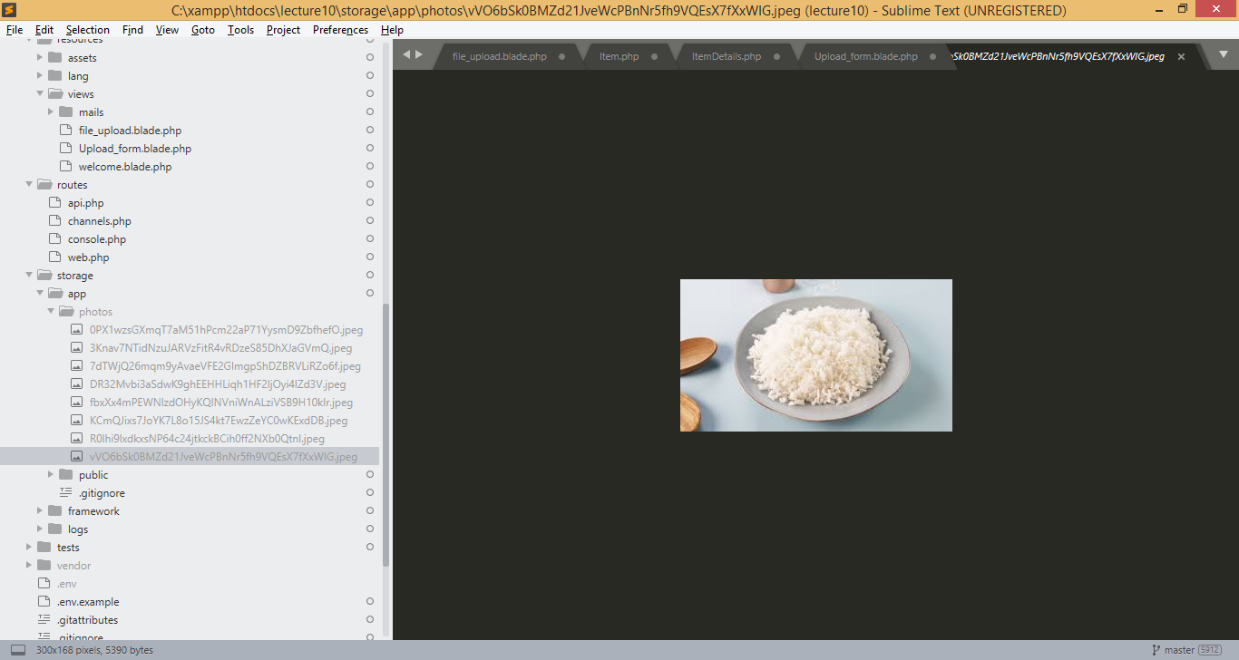
Result

Slide 27
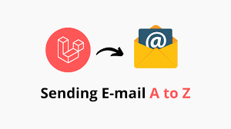
Sending text by email
Sending email doesn't have to be complicated. Laravel provides a clean, simple email API powered by the popular SwiftMailer library. Laravel and SwiftMailer provide drivers for sending email via SMTP, Mailgun, Postmark, Amazon SES, and sendmail, allowing you to quickly get started sending mail through a local or cloud based service of your choice.

Slide 28
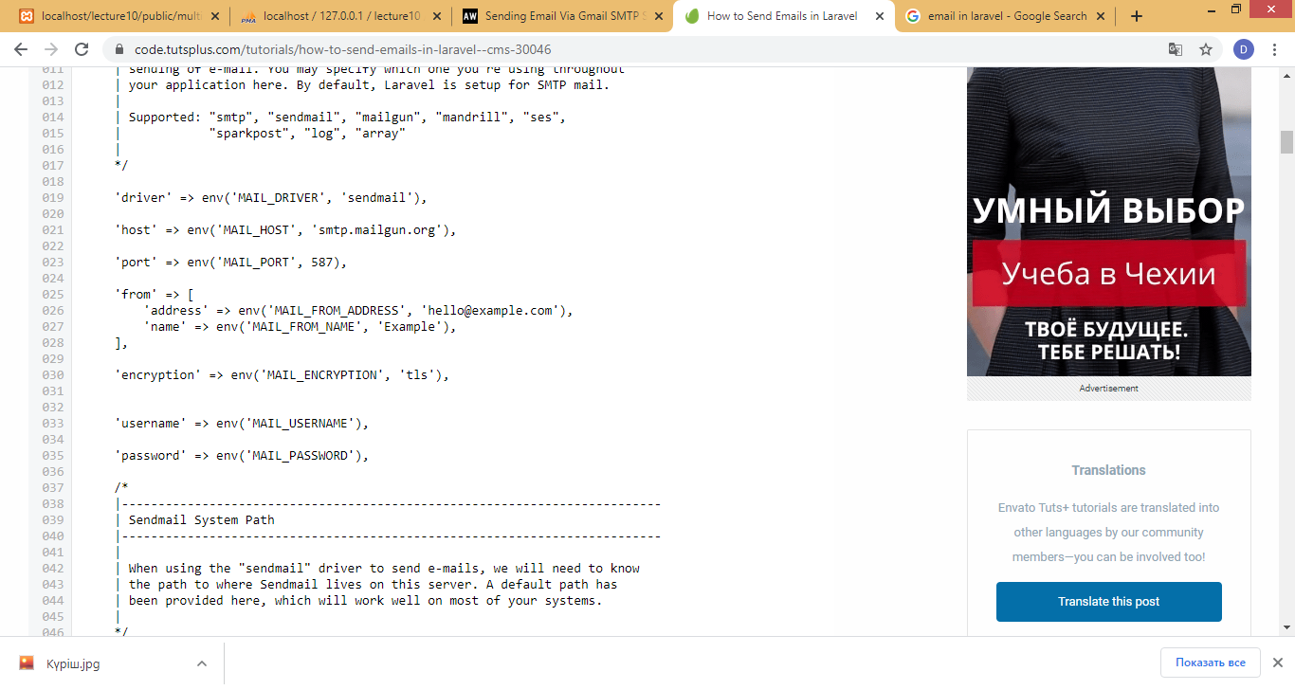
Setting Up the Prerequisites
Laravel implements a wrapper on top of the SwiftMailer library that makes email management very easy to configure and use at the same time. You can find the default mail settings at config/mail.php.

Slide 29
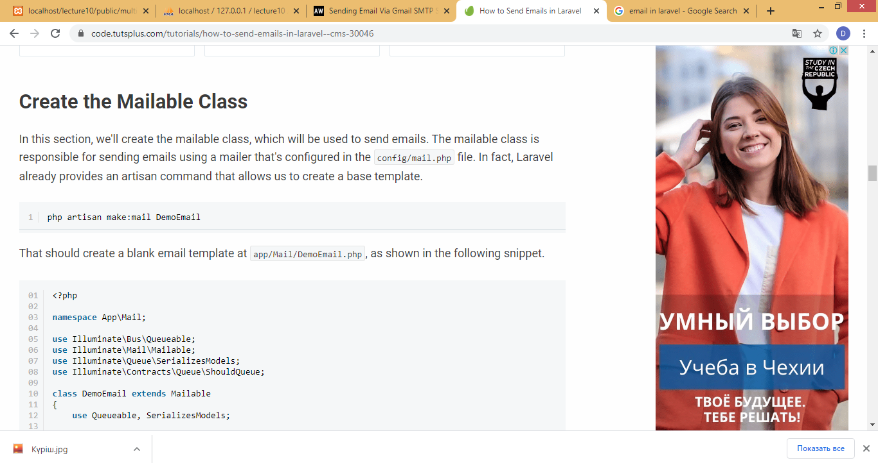
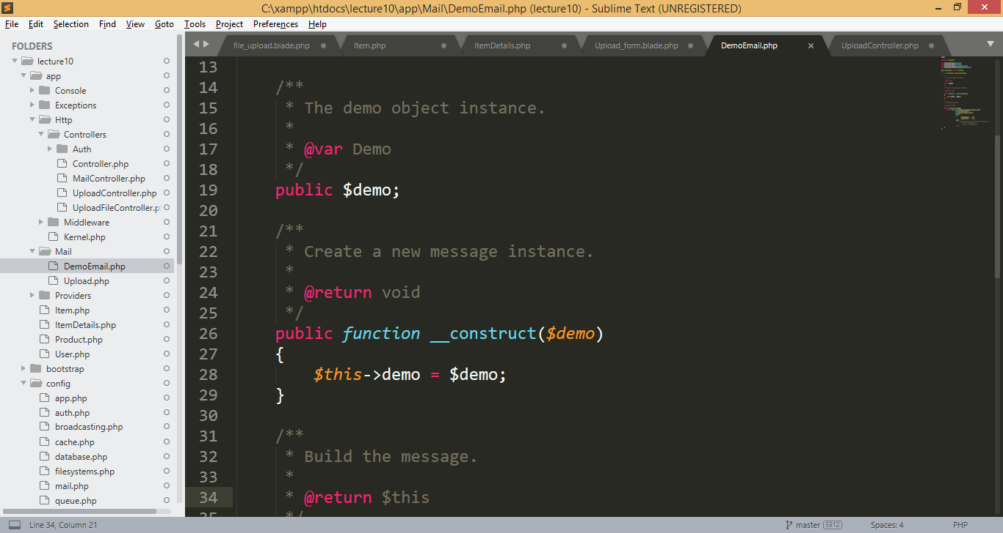
Step 1
DemoEmail.php

Slide 30
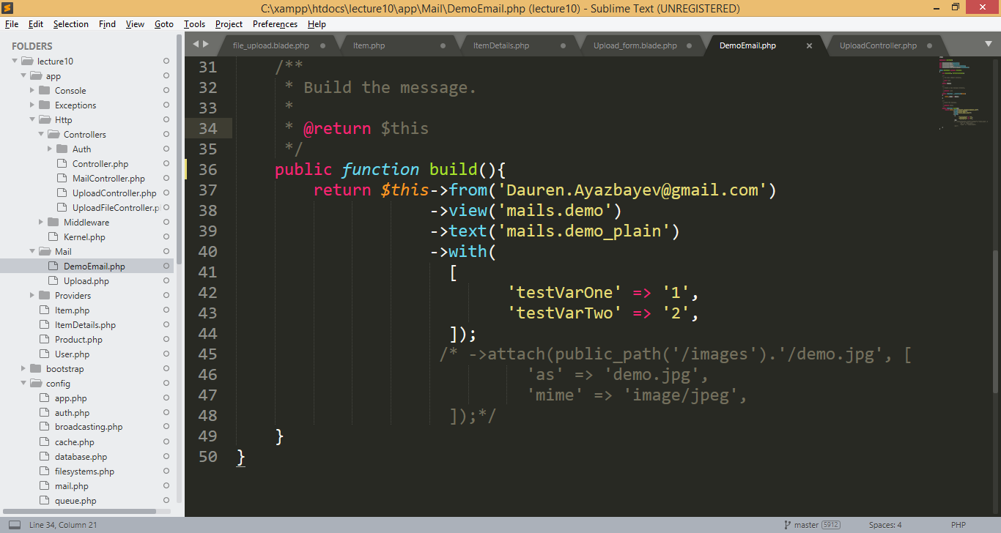
Step 1 (continuation)
DemoEmail.php
From which address the message will be sent.

Slide 31
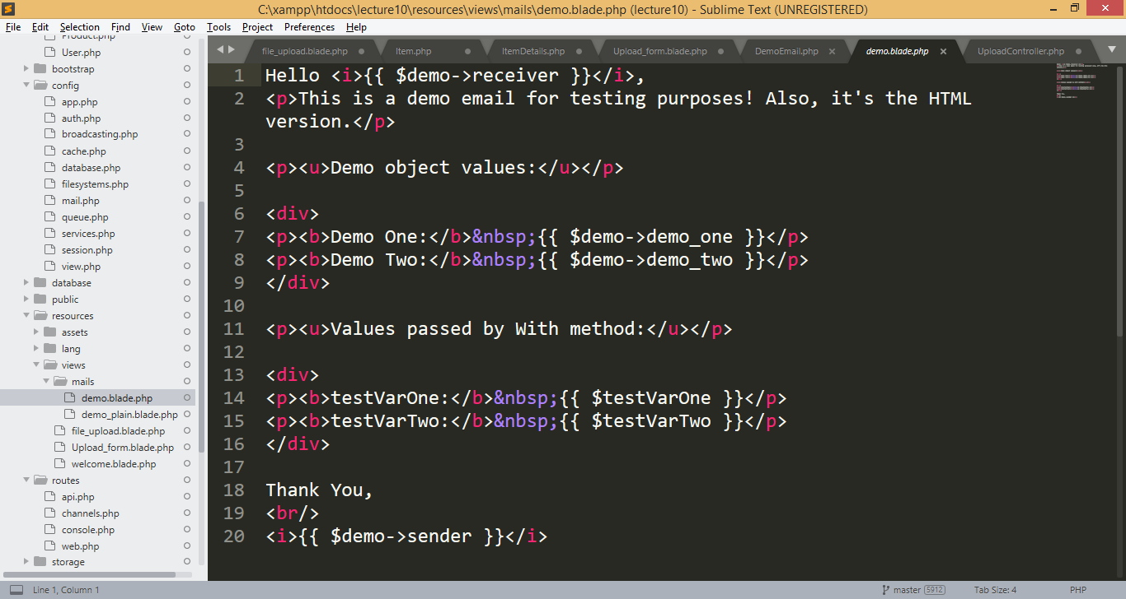
Step 2
Open new view resources/views/mails/demo.blade.php.

Slide 32
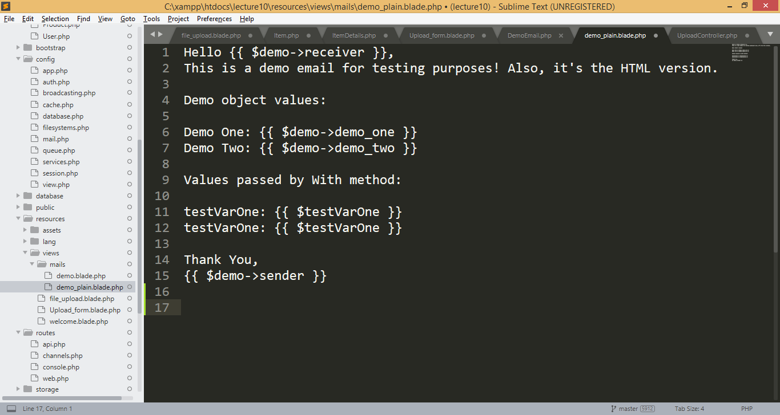
Step 3
Also, let's make the plain text version of that file at resources/views/mails/demo_plain.blade.php

Slide 33
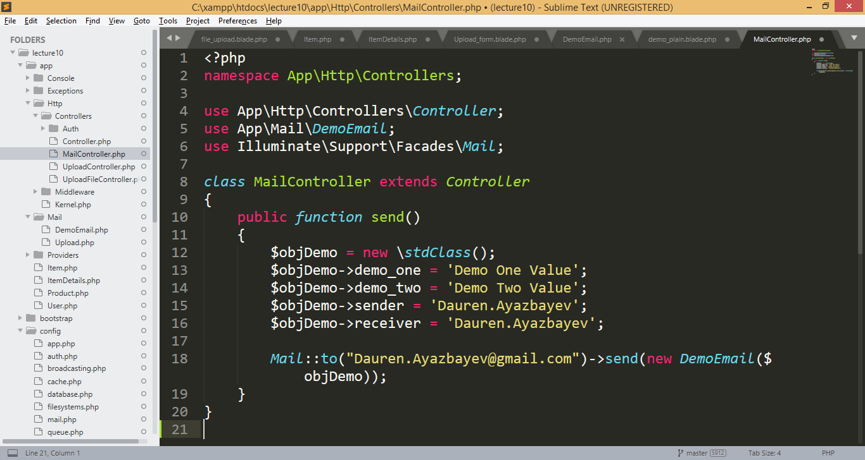
Step 4
Make a controller file at app/Http/Controllers/MailController.php with the following contents.
To which email address you want send message.

Slide 34
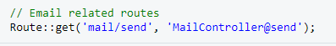
Step 5
Adding route to routes/web.php file.

Slide 35
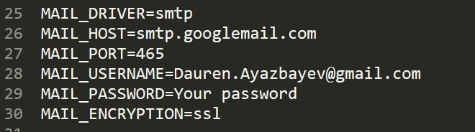
Step 6
.env file

Slide 36
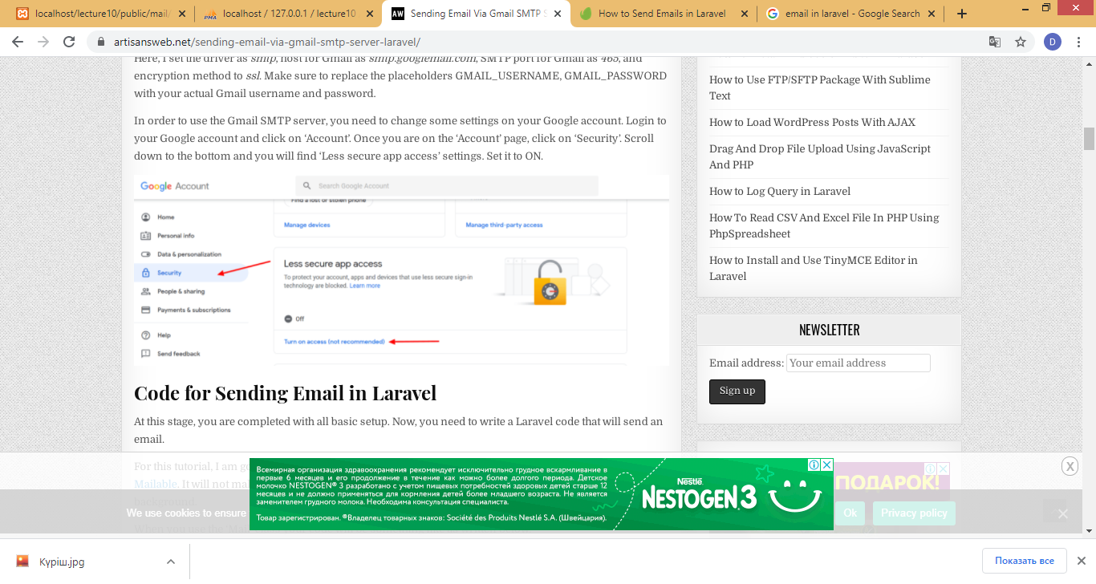
Step 7

Slide 37
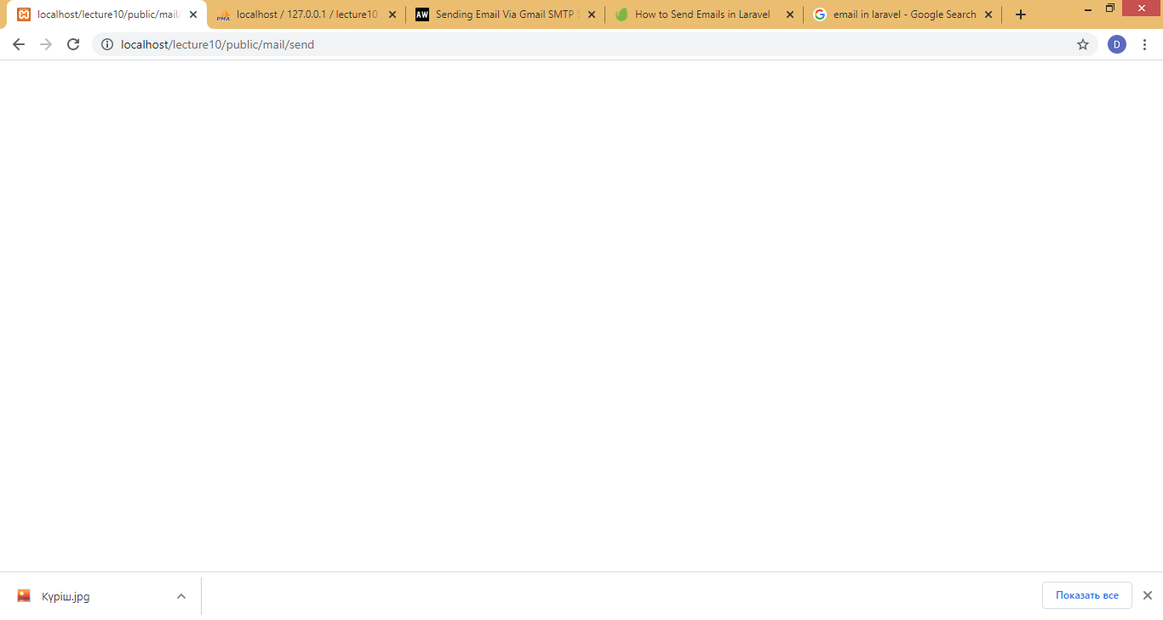
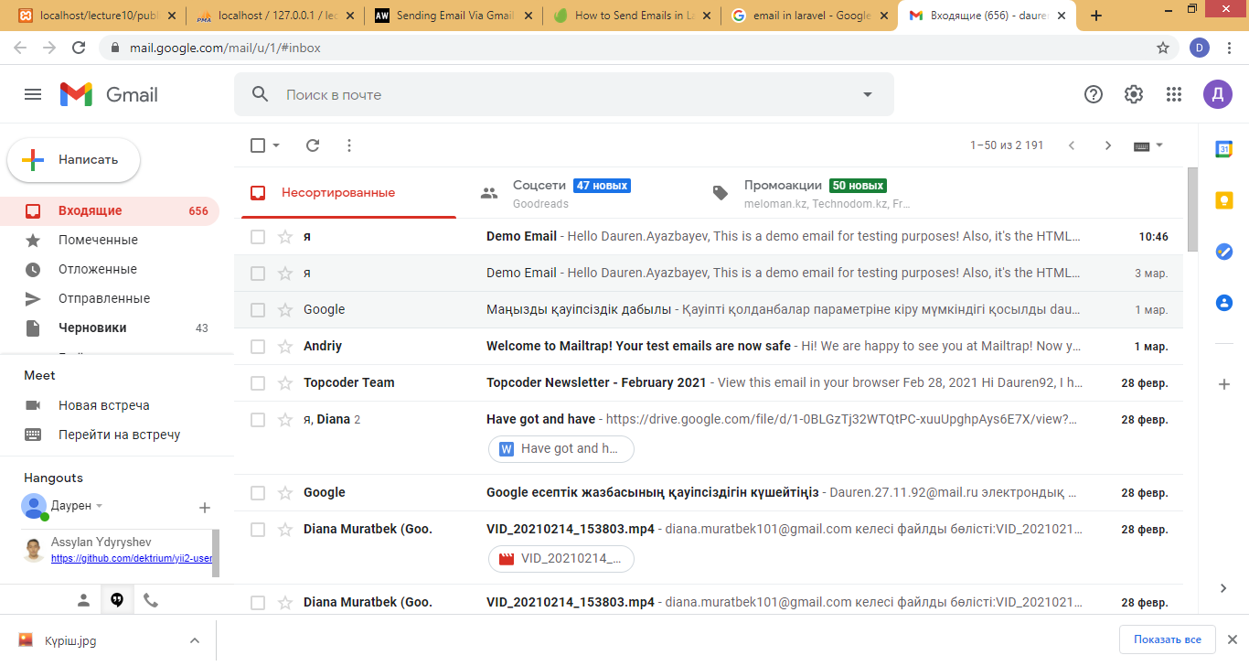

Result

Slide 38
Used links
https://laravel.com/docs/8.x/filesystem
https://www.tutorialspoint.com/laravel/laravel_file_uploading.htm
https://www.cloudways.com/blog/laravel-multiple-files-images-upload/
https://artisansweb.net/sending-email-via-gmail-smtp-server-laravel/
https://code.tutsplus.com/tutorials/how-to-send-emails-in-laravel--cms-30046

